Slide 1

Real Time Sign Language Detection using TensorFlow Object Detection and Python
Shrestha Sinha (21BAI1763)
Abhishek Panigrahi (21BAI1773)

Slide 2
Content
Problem Statement
Objective of the proposed model
Code Implementation
&
Result
Journal References
&
Literature Review
Dataset Acquisition & Description
Improvisation in Methodology
Methodology
&
Proposed ML model

Slide 3

Problem Statement
Sign language which is used by speech-impaired people is not known to common people. When speech impaired people need to get services at public institutions from a public servant, communication barrier occurs as the public servant may not understand their need as they communicate through sign language. Due to this access or offer of public services to speech-impaired people are limited. So, in order to break the barrier, there is a need to develop a system where both can understand and promote effective communication.

Slide 4
Objective of the Project
Social Impact
Technological Innovation
Challenges and Solutions
Practical Implementation
Engagement and Feedback
Emphasizing the significance of addressing communication barriers for individuals with hearing impairments and how our project contributes to a more inclusive society.
Demonstrating the application of advanced technologies, specifically TensorFlow Object Detection and Python, in real-time sign language recognition.
Discussing the complexities and limitations associated with interpreting diverse sign gestures in real-time and presenting solutions to overcome these challenges.
Showcasing the system's practical implementation, including the training process, real-time processing, and user interface design.
Encouraging audience engagement through discussions on potential applications, ethical considerations, and feedback mechanisms for continual improvement.

Slide 5
Journal References
Journal Name | Author of Journal | Link to the Journal | Year
ResearchGate | Anup Lal Yadav , Gurpartap Singh , Satbir S Sehgal | Sign language recognition Using Python | 2022
International Journal of Research in Advent Technology | Dr. M. Arathi , K. Mahimanvitha | Real-time Sign Language Recognition using Deep Learning | 2023
International Journal of Creative Research Thoughts | Ravindra Bula, Dipalee Golekar, Rutuja Hole, Sidheshwar Katare, S. R. Bhujbal | Real-Time Sign Language Recognition using Image Processing | 2022
arXiv – Cornell University | Sharvani Srivastava, Amisha Gangwar, Richa Mishra, Sudhakar Singh | Real-Time Sign Language Recognition using a Hybrid CNN-LSTM Model | 2022
International Research Journal of Engineering and Technology | Sahil Rawal , Dhara Sampat , Priyank Sanghvi | Real-Time American Sign Language Recognition using Convolutional Neural Networks | 2022

Slide 6
Literature Review (Journals paper 1 & 2)
The first paper, "Sign language recognition Using Python," found on ResearchGate, discusses the implementation of sign language recognition algorithms using the Python programming language. This paper likely delves into various Python libraries and techniques, such as OpenCV and machine learning frameworks like TensorFlow or PyTorch. It covers preprocessing methods for image or video data, feature extraction, and classification algorithms tailored for recognizing sign language gestures. This paper serves as a foundational resource for developers interested in creating sign language recognition systems using Python.
The second paper, "Real-time Sign Language Recognition using Deep Learning," published in the International Journal of Research in Advent Technology, focuses on employing deep learning techniques for real-time sign language recognition. The paper likely utilizes advanced neural network architectures, such as convolutional neural networks (CNNs) or recurrent neural networks (RNNs), to process temporal sequences of hand gestures.
Then use TensorFlow and Keras to build an LSTM model which is able to recognize and predict the action from the live video. Emphasis is placed on achieving high accuracy and low latency suitable for real-time applications, with a focus on capturing live video streams, preprocessing the data, and feeding it into the deep learning model for gesture classification.

Slide 7
Literature Review (Journals paper 3 & 4)
The third paper, "Real-Time Sign Language Recognition using Image Processing," featured in the International Journal of Creative Research Thoughts, likely captures hand gestures through a camera or video input and preprocesses the images using various techniques such as edge detection, contour analysis, or color segmentation. The data used for this system includes 6000 Image of English letters. Subsequently, pattern recognition algorithms (SLR), possibly machine learning classifiers, are applied to recognize and interpret the gestures. The aim is to develop efficient algorithms that can operate in real-time with minimal computational overhead.
The fourth paper, "Real-Time Sign Language Recognition using a Hybrid CNN-LSTM Model," published on arXiv, a novel approach to real-time sign language recognition is proposed using a hybrid convolutional neural network (CNN) - long short-term memory (LSTM) model. This hybrid architecture aims to capture both spatial and temporal dependencies in sign language gestures, enhancing recognition accuracy. CNNs are employed to extract spatial features from hand gesture images, while LSTMs capture temporal dynamics in the sequence of gestures. This integration enables the model to effectively recognize complex sign language gestures in real-time scenarios.

Slide 8
Literature Review (Journals paper 5)
The fifth paper, "Real-Time American Sign Language Recognition using Convolutional Neural Networks," published in the International Research Journal of Engineering and Technology, presents a pivotal contribution to real-time communication accessibility for the hearing impaired. By employing Convolutional Neural Networks (CNNs), the study addresses the pressing need for accurate and efficient recognition of American Sign Language (ASL) gestures. The significance of this work lies in its tailored application of CNNs to ASL recognition, leveraging their prowess in hierarchical feature learning from visual data. Emphasis is placed on achieving real-time performance crucial for interactive applications. The paper likely delves into dataset characteristics, methodologies for data collection and annotation, and strategies for addressing dataset biases. Evaluation metrics, including accuracy and latency, are employed to assess model performance, possibly comparing results with state-of-the-art approaches. Overall, the paper advances assistive technologies by demonstrating the feasibility of CNN-based ASL recognition systems, fostering inclusivity and enhancing communication opportunities for the deaf and hard of hearing community.

Slide 9
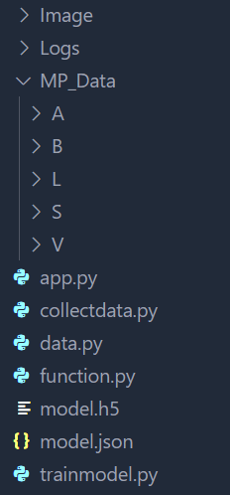

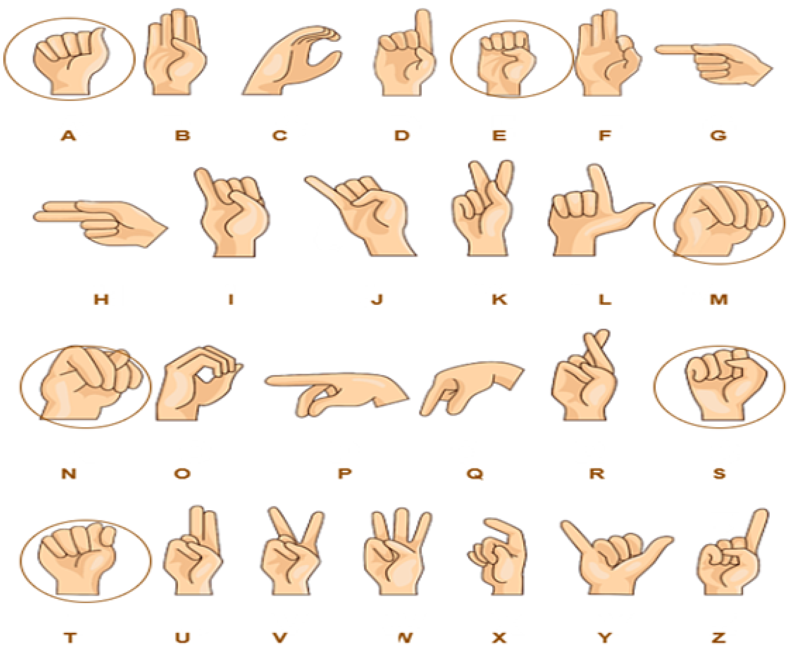
Dataset Description
Dataset folder schema
The created dataset is made up of signs representing alphabets in Sign Language. For every alphabet, 30 images are captured to make the dataset. The images are captured with every corresponding click providing time to record gesture with a bit of difference every time and a break of few seconds are given between two individual signs, i.e., to change the sign of one alphabet to the sign of a different alphabet. The captured images are stored in their respective folder.
For data acquisition, dependencies like cv2, i.e., OpenCV, os, and time have been imported.
Sign Language Detection using Deep Learning Models

Slide 10
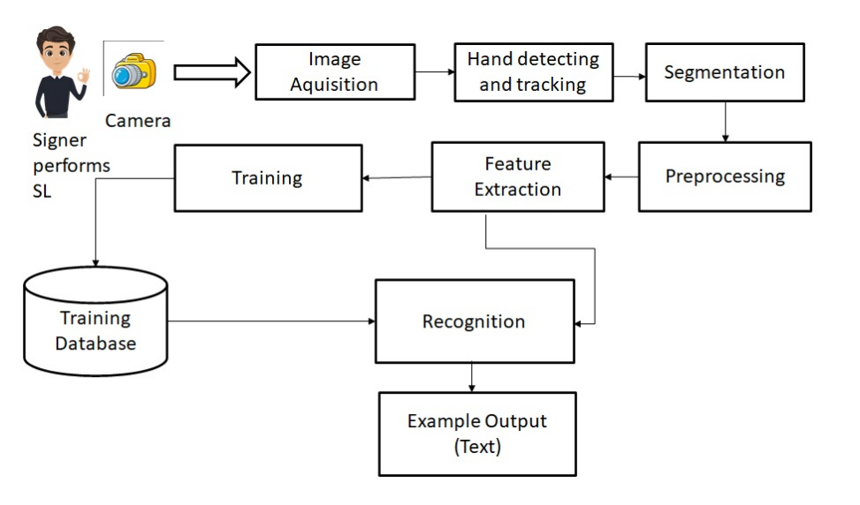
Flow Diagram
Sign Language Detection using Deep Learning Models

Slide 11
Proposed methodology
Image Acquisition
Data Segmentation
Feature Extraction
Extracting an image from a source, typically a hardware-based source, for process of image processing. Web Camera is the hardware-based source in our
project. It is the first step in the workflow sequence because no processing can be done without an image.
The method of separating objects or signs from the context of a captured image. Context subtracting, skin-color detection, and edge detection
are all used in the segmentation process. The motion and location of the hand must be detected and segmented in order to recognize gestures.
Predefined features such as form, contour, geometrical feature (position, angle, distance, etc. ), colour feature, histogram, and others are extracted from the preprocessed images and used later for sign classification or recognition. a step in the dimensionality reduction process that divides and organizes a large collection of raw data, reduced to smaller, easier-to-manage classes
Model Training
Evaluation Metrics
Real-Time Processing Pipeline
Trained a custom deep learning model using the selected framework, fine-tuning it to recognize intricate hand movements inherent in sign language expressions.
Employed accuracy, precision, recall, and user satisfaction metrics for comprehensive evaluation of the model's performance.
Integrated the trained model into a real-time processing pipeline using Python, ensuring optimal performance and low-latency response on live video feeds.
Sign Language Detection using Deep Learning Models

Slide 12
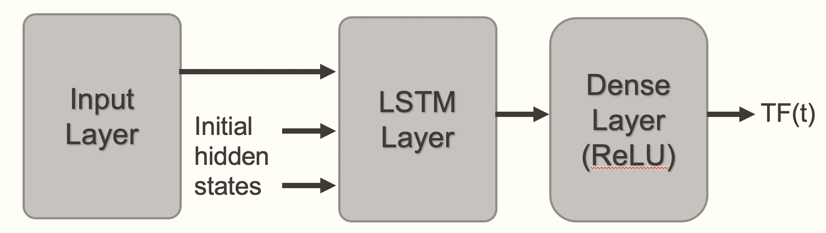
Proposed ML model – LSTM (RNN)
Sequential Dependency
Variable-Length Sequences
Temporal Dynamics
Non-linearity Handling
Robustness to Variations
Sign Language Detection using Deep Learning Models

Slide 13
Hyperparameters for the model
LSTM Layer Parameter
No. of LSTM units = 3
Activation function
= ‘relu’
Input Shape
= (30,63)
Return Sequences
Training Parameters
Epoch = 200
Optimizer
= ‘Adam’
Dense Layer Parameter
No. of Dense units
= 3
Activation function
= ‘relu’ in hidden,
‘softmax’ in outermost
Loss Function
= 'categorical_crossentropy'
Sign Language Detection using Deep Learning Models

Slide 14
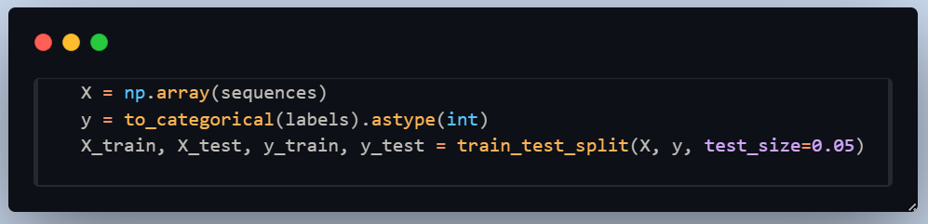
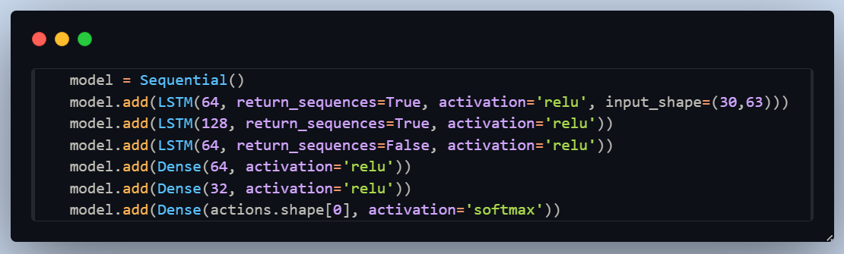
Code Implementation
Train & Validation set splitting of dataset
Sequential model creation

Slide 15
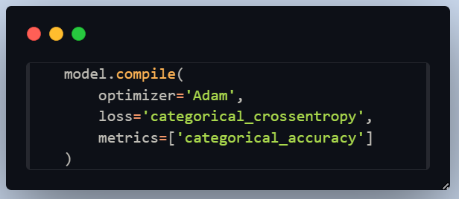
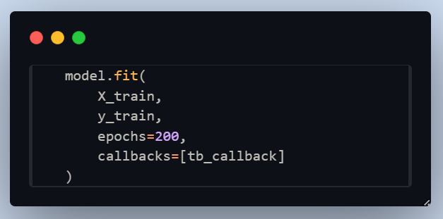
Code Implementation
Model compilation with loss function and optimizer
Training the CNN model with the training and validation dataset

Slide 16
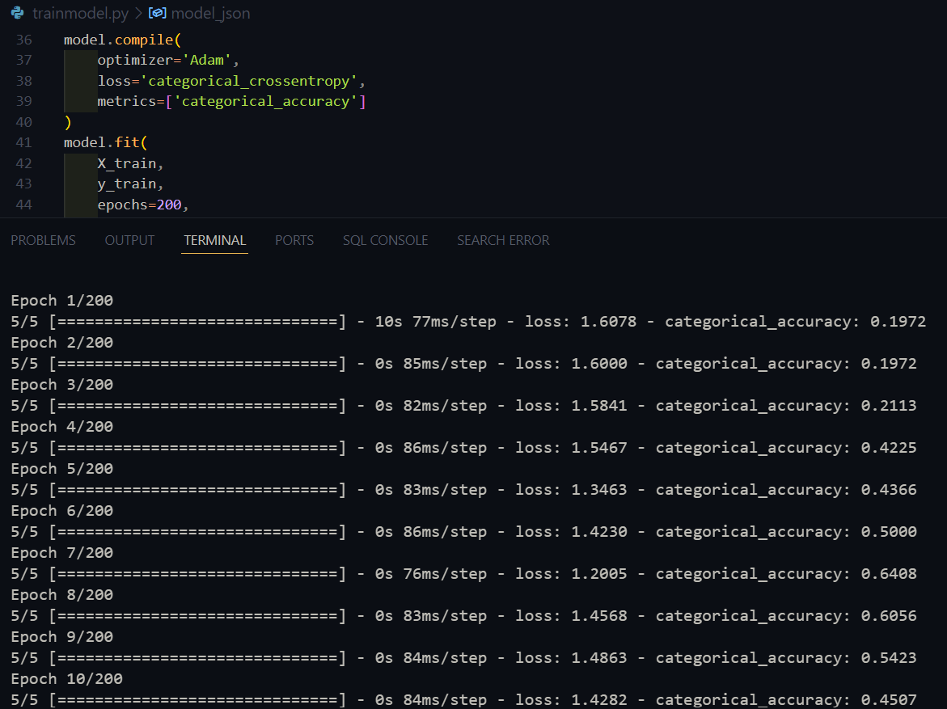
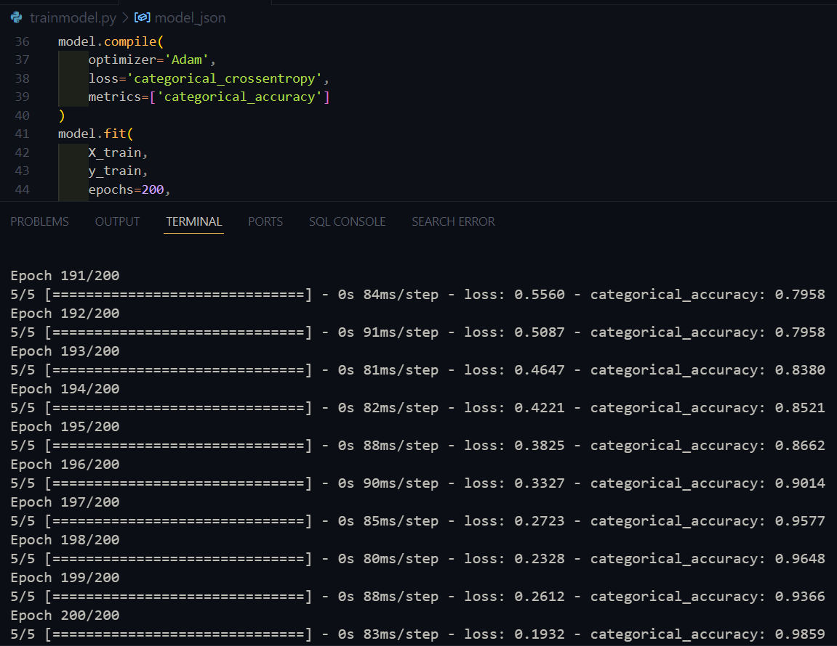
Model Training - Adam Optimizer
Initial Epoch
Final Epoch

Slide 17
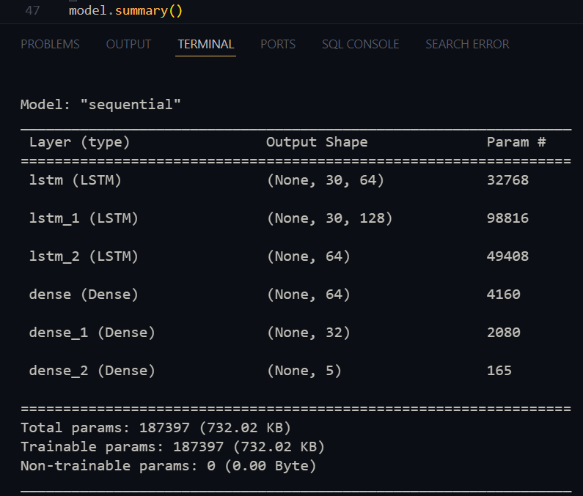
Model Summary

Slide 18



Improvisation in Proposed Methodology
Diversified Dataset Collection
Epoch Count Variation
Hyperparameter Tuning
Sign Language Detection using Deep Learning Models

Slide 19
THANK YOU
THANK YOU
Presentation Link : https://drive.google.com/file/d/1kIW23H0CoLm0ucOKvTyG3y_opLlY_adN/view?usp=sharing
Sign Language Detection using Deep Learning Models

